Slide 1

Lecture 2

Slide 2

Content
Classification of numbers.
Divisibility rules.
Factorials.
Unit digit calculation.
Number of Factors.

Slide 3
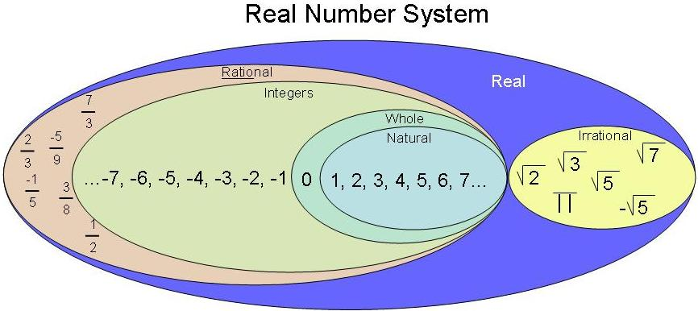
Types of numbers

Slide 4
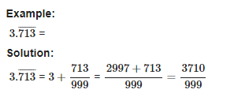
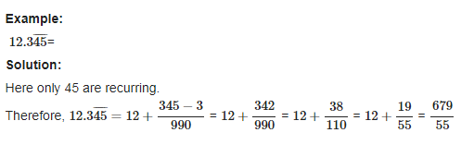
Conversion of a decimal number to fraction:

Slide 5
Question. Find the rational form of the recurring rational 0.5333333333
[A] 11/99
[B] 1/3
[C] 8/15
[D] 13/30

Slide 6
Question. Convert 37.565656565656……………. into P/Q
A)3719/99 B)3663/90 C)3443/990 D)None of these

Slide 7
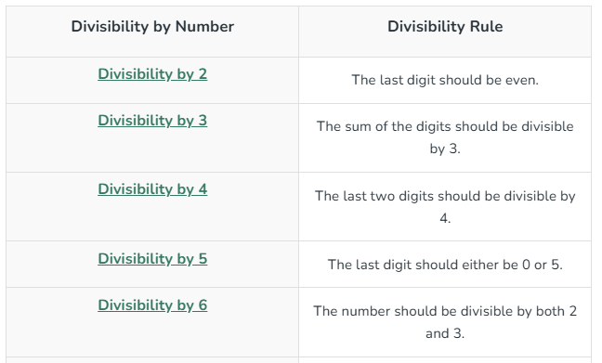
Divisibility Rules

Slide 8
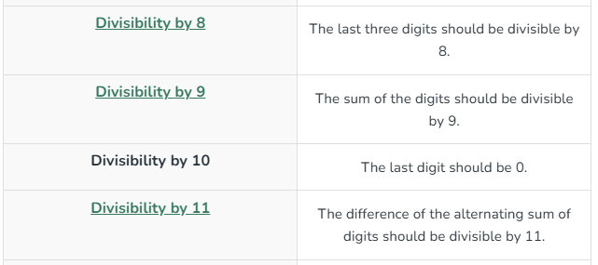

Slide 9
Question: If number 259292N is divisible by 2. How many values N can take?
[A] 4
[B] 5
[C] 3
[D] 6

Slide 10
Question: What should come in place of N if 545K5 is divisible by 9?
[A] 7
[B] 8
[C] 9
[D] 2

Slide 11
Question: For what values of P number 36345472P34 is exactly divisible by 9.
[A] 3
[B] 4
[C] 6
[D] 7

Slide 12
Question: For what values of N number 549724N is exactly divisible by 6.
[A] 2 & 8
[B] 4 & 6
[C] 2 & 6
[D] 6 & 8

Slide 13
Question: For what values of K number 99857K32 is exactly divisible by 11.
[A] 1
[B] 0
[C] 3
[D] 4

Slide 14
Question: What should come in place K if 4857K is divisible by 88?
[A] 6
[B] 8
[C] 2
[D] 4

Slide 15
Factorials Trailing zeros (Number of zeros at the end)
Concept: In multiplication zero can be produced when we have a pair of 2 and 5. So, in order to find no. of zeros at the end, the pair of 2 and 5 need to be counted.
Example: 2^3 x 5 x 9 x 8 x 24 x 15 Find number of zeros at the end.

Slide 16
Question: Find number of trailing zeros in 50!
[A] 12
[B] 10
[C] 15
[D] 27

Slide 17
Question: Find number of trailing zeros in 154!
[A] 35
[B] 31
[C] 34
[D] 37

Slide 18
Question: Find number of trailing zero in 100!+200!+300!
[A] 24
[B] 49
[C] 73
[D] None of these

Slide 19
Question: Find number of trailing zero in 100! X 200!
[A] 24
[B] 49
[C] 73
[D] None of these

Slide 20
Unit Digits:
Right most digit of a number is called Unit digit.
For e.g. 278 × 623 what will be the unit digit?
8 x 3 = 24 The last digit is 4

Slide 21
Unit Digit of higher power numbers

Slide 22
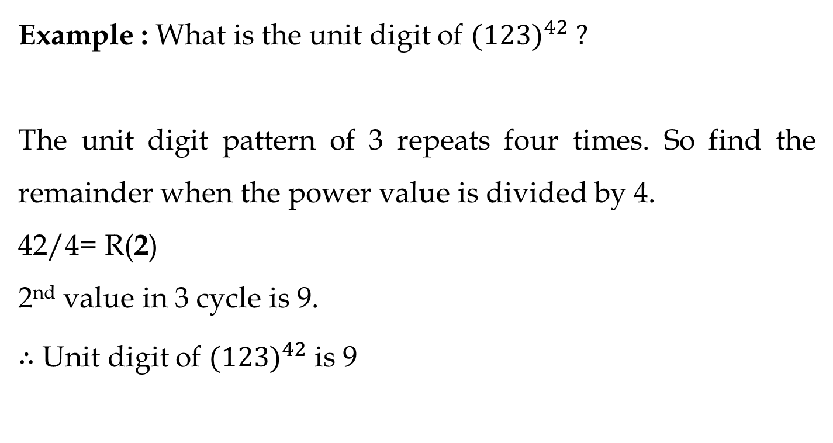

Slide 23
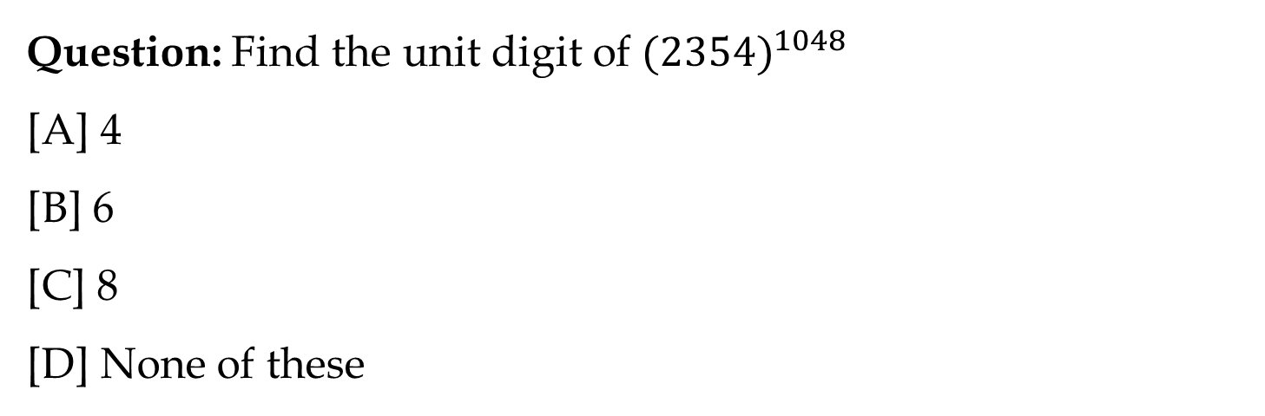

Slide 24
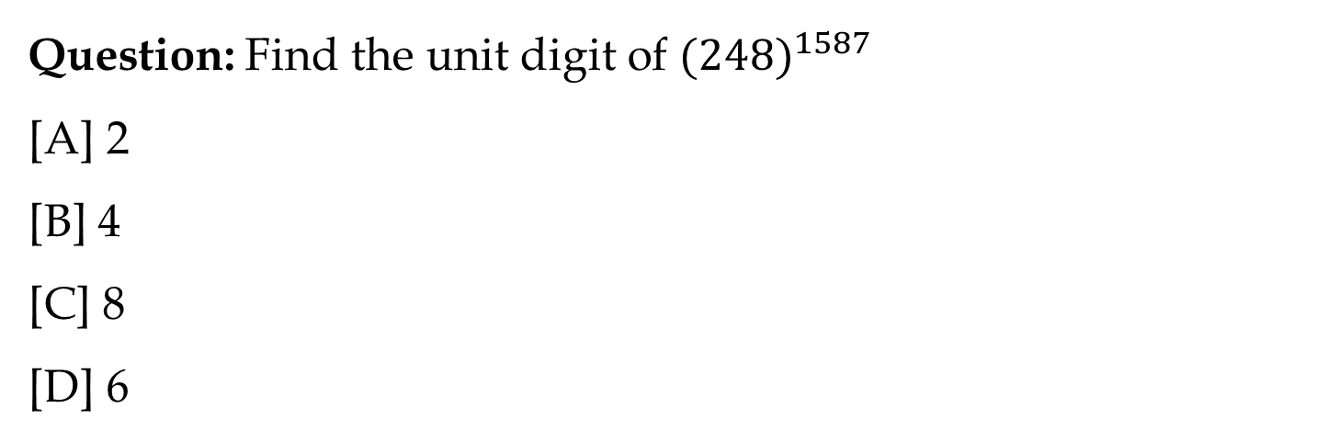

Slide 25
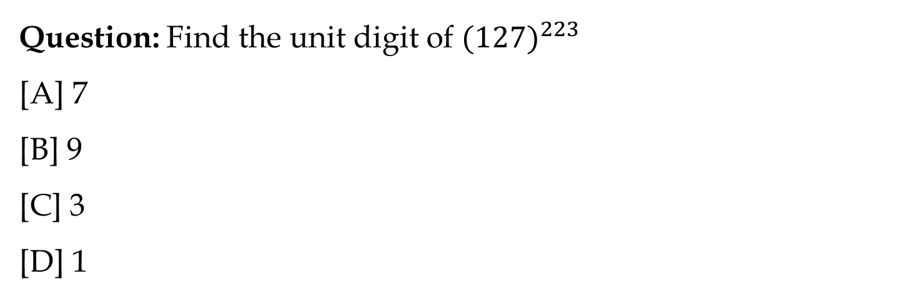

Slide 26
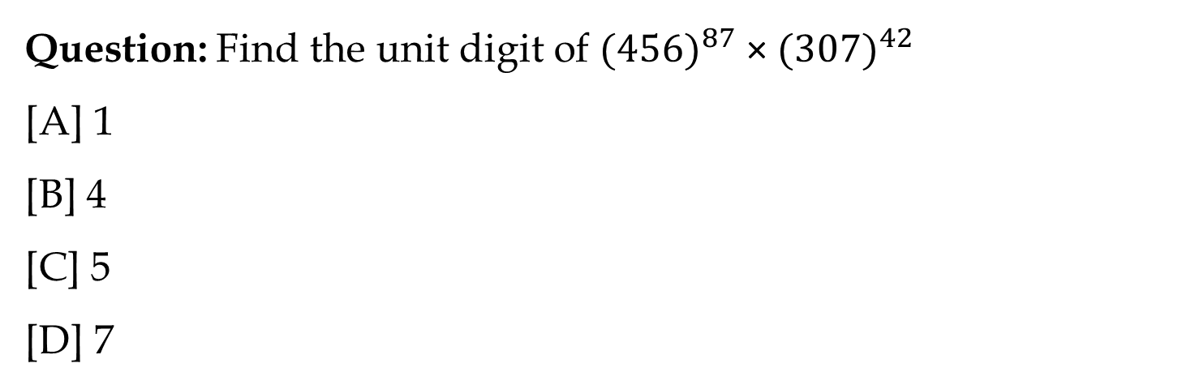

Slide 27


